Slide 1
LECTURE 18
ROBIN COLLINS, “A SCIENTIFIC ARGUMENT FOR THE EXISTENCE OF GOD: THE FINE-TUNING DESIGN ARGUMENT”

Slide 2

ROBIN COLLINS

Slide 3
AN INFORMAL ANALOGY
SUPPOSE WE FIND A FULLY FUNCTIONING BIOSPHERE ON MARS. WE WOULD CONCLUDE THAT IT WAS DESIGNED BY SOME INTELLIGENT BEINGS.
THIS IS NOT COMPLETELY ANALOGOUS. IN THAT CASE, WE KNOW SOMETHING ABOUT BIOSPHERES ALREADY (COMPARE WILLIAM PALEY’S WATCH – ARGUMENT FROM DESIGN).
THERE IS SOME ANALOGY WITH THE UNIVERSE. BUT EVALUATING ANALOGIES IS A TRICKY,
DELICATE , AND INTUITIVE BUSINESS.

Slide 4
ARGUMENTS FROM DESIGN
AN ARGUMENT FOR THE EXISTENCE OF GOD BASED ON THE APPARENT DESIGN IN THE UNIVERSE OR IN LIVING ORGANISMS IS AN ARGUMENT FROM DESIGN. THE SUCCESS OF DARWIN’S THEORY OF EVOLUTION HAS SERIOUSLY WEAKENED (SOME THINK, DESTROYED) THE FORCE OF THE LATTER VERSIONS (SEE RICHARD DAWKINS, DANIEL DENNETT. ALSO SEE PLANTINGA FOR ATTEMPTED REBUTTALS AND COUNTER-ARGUMENTS).

Slide 5
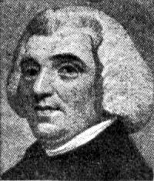
WILLIAM PALEY (1743 -1805)

Slide 6
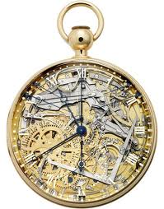
PALEY USED A WATCH

Slide 7
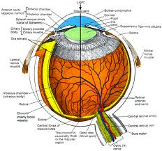
AND COMPARED IT TO THE HUMAN EYE

Slide 8
DARWIN’S THEORY OF EVOLUTION HAS TAKEN THE STARCH OUT OF THIS VERSION OF THE DESIGN ARGUMENT
RANDOM VARIATIONS OF GENETIC TRAITS AND SURVIVAL OF THE FITTEST CAN ACCOUNT FOR MANY FEATURES OF LIVING ORGANISMS THAT SEEM TO BE DELIBERATELY DESIGNED.

Slide 9
COLLINS USES THE LAWS OF NATURE, THE PARAMETERS (CONSTANTS) IN THE LAWS, AND THE INITIAL CONDITIONS OF
THE BIG BANG
MANY PHYSICISTS AGREE WITH COLLINS ABOUT THIS.

Slide 10
COLLINS ARGUES THAT THE FINE-TUNING EVIDENCE CONFIRMS THE HYPOTHESIS OF THEISM MORE THAN THE ATHEISTIC UNIQUE- UNIVERSE HYPOTHESIS
HE ALSO ARGUES, INDEPENDENTLY, THAT THE ATHEISTIC MANY-UNIVERSES HYPOTHESIS “OUGHT TO BE REJECTED.” HE SHOULD SAY: “CERTAIN THINGS COUNT STRONGLY AGAINST THIS HYPOTHESIS AS COMPARED TO THE HYPOTHESIS OF THEISM.”

Slide 11
HIS ARGUMENT IS DEDUCTIVELY VALID, BUT ITS CONCLUSION IS THAT ONE THING (THEISM) IS MADE MORE PROBABLE THAN AN ATHEISTIC HYPOTHESIS
THIS MAY BE CONFUSING. THE ARGUMENT HE GIVES IS SUPPOSED TO BE (AND IS) DEDUCTIVELY VALID. BUT THE CONCLUSION CONCERNS INDUCTIVE SUPPORT!

Slide 12
COLLINS’S ARGUMENT USES “THE PRIME PRINCIPLE OF CONFIRMATION”
HIS DEDUCTIVELY VALID ARGUMENT
CONCERNS ONLY THE ATHEISTIC UNIQUE UNIVERSE HYPOTHESIS (AND THE THEISTIC HYPOTHESIS). IT DOESN’T CONCERN , AND HAS NOTHING TO DO WITH, THE ATHEISTIC MANY-UNIVERSES HYPOTHESIS.

Slide 13
PRIME PRINCIPLE OF CONFIRMATION (“THE LIKELIHOOD PRINCIPLE”)
When comparing two hypothesis with respect to certain observed evidence, the hypothesis that would make it more likely to observe that evidence is more highly confirmed by the observation (i.e., is made more probable).

